Slide 1
Workload Optimized Silicon
2016 June 30

Slide 2
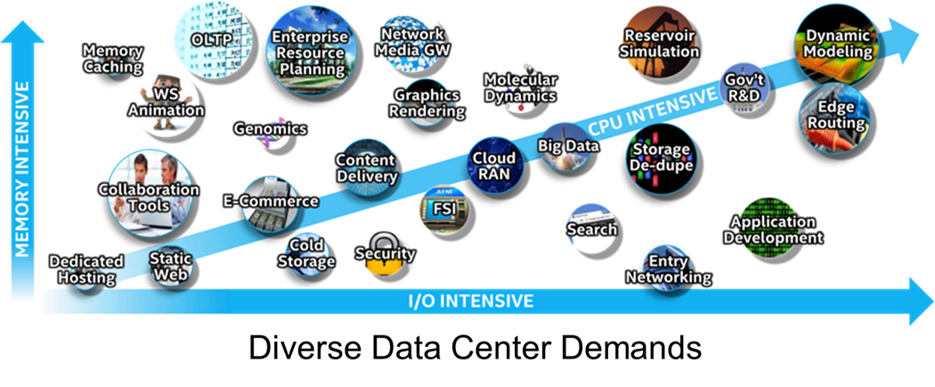
Workload Optimized Silicon
Cost effectively optimizing a server’s processor to the workload it performs
Notes:
Organizations are using a diverse set of workloads. Optimizing each workload is a challenge for the data center. To meet this challenge, Intel has developed a number of different processor lines that meet the compute needs for these diverse server workloads and maximize performance and ROI.
Workloads requirements matched to the optimal mix of CPU, memory, I/O, and advanced technology built into the latest Intel processor provide peak performance. Traditionally, customers have standardized on servers configured to meet general-purpose workloads – sacrificing workload optimization for data center standardization.
This standardized approach essentially allows diverse workloads to run on any server and attempts to maximize ROI by reducing the number of server configurations maintained in the data center. Adopting a workload-optimized technique when configuring servers in the data center can lower overall datacenter costs while providing several major advantages:
Provides servers with the best CPU, memory and I/O performance for the workload improving performance and throughput for critical application
Takes advantage of the advanced Intel technology built into the processor, further optimizing server performance for specific workloads
Orchestrates with the most advanced Data Center Infrastructure Management (DCIM),the marriage of information technology and data center facility management disciplines, to optimize overall datacenter costs and performance

Slide 3

Workload Optimized Server Selection Approach
Maximizes Return on Investment
Maximizes Workload Performance
Four Areas of Focus
  Business Case - including TCA and TCO
  Workload Characteristics – Technical Profile of Workload
  Scale – Planned Growth and Peak Workloads
  Application Considerations – Optimize Software Pricing Models
Notes:
Of course, optimizing the processor is not the only consideration for customers in data center purchase decisions. Customers challenged to provide the best possible workload performance in the most cost effective manner measure new data center upgrades based upon return on investment (ROI).
Maximizing ROI using a workload-optimized approach focuses on four main areas:
Business case – Acquisition costs of the hardware, software and services required, along with total cost of ownership (TCO) weigh against the business value of the server. Maximizing the workloads performed on a server increases its business value and lowers TCO.
Workload characteristics – what is the technical profile of the workload? Does it scale with cores, is latency or throughput most important, require large memory or fast I/O to maximize performance? Configuring the server to maximize workload performance allows more work to be done on each server, lowering overall costs.
Scale – How does the acquisition handle peak workloads and future growth? Planning growth within the server prevents the need for additional servers, lowering overall costs.
Application considerations – Workload optimized silicon can also take advantage of the pricing models for application software. Minimizing the cores in a server can reduce the overall cost for applications priced per core. Maximizing processor frequency can optimize costs for applications priced per processor.

Slide 4

Application Benefits of Workload Optimized Silicon
Matching Processor to the Application/Workload
  Optimizes application/workload performance
  Can reduce the total servers needed
  Takes advantage of processor features
  Provides application/workload scale
  Optimizes TCO
Notes:
Matching the processor to the application or workload will optimize performance of the server in the datacenter. While each environment is unique, this chart can be used as a general guideline when selecting a processor

Slide 5
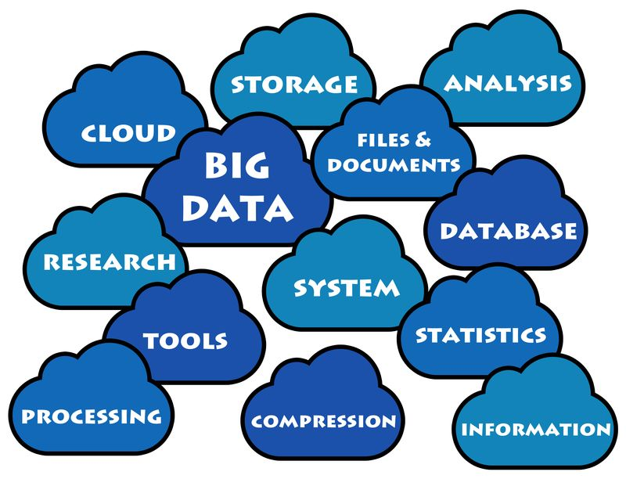
Optimizing Workloads to Intel Processor
Intel Guidelines Match Processor to Workload
E7 Processor Family
  Ideal for Scale-Up Workloads
  Provides High Memory and I/O Bandwidth
E5 Processor Family Features
  Ideal for Scale-Out Workloads
  Caters to a Wide Range of Applications
    Provides High Core Count Options
    Provides High Frequency Options

Slide 6
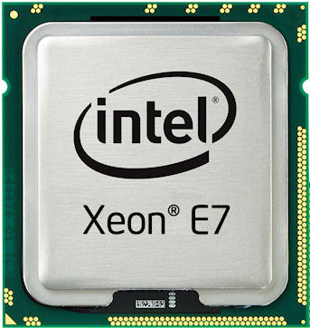
Workloads for E7 Processor Family
Notes:
General guidelines are useful to match the general capabilities of a processor to a workload category.
Intel has provided more specific guidelines based upon specific workload applications where Intel processors are deployed.
In these charts, the dark green indicates where a processor is very applicable for a workload. The lighter green indicates where a processor is applicable for the workload. If a processor is not listed for a particular workload, it is not optimal for that workload

Slide 7
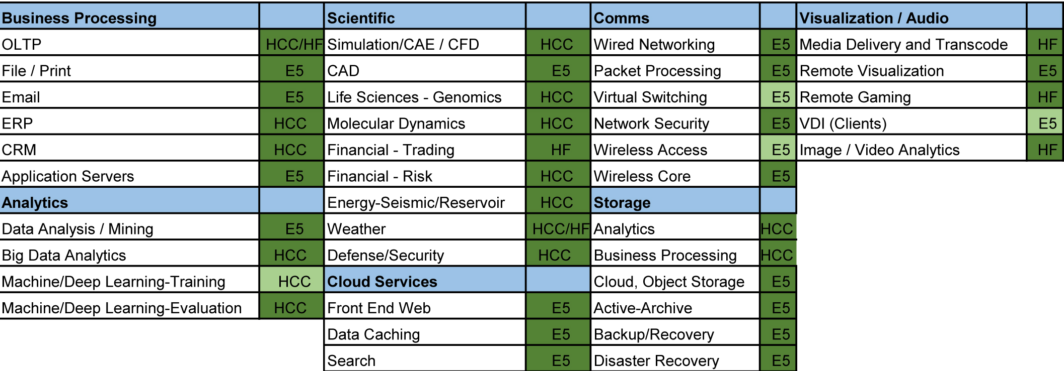
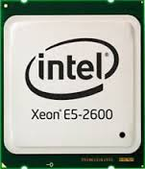
Workloads for Intel Processor E5 Family
Notes:
General guidelines are useful to match the general capabilities of a processor to a workload category.
Intel has provided more specific guidelines based upon specific workload applications where Intel processors are deployed.
In these charts, the dark green indicates where a processor is very applicable for a workload. The lighter green indicates where a processor is applicable for the workload. If a processor is not listed for a particular workload, it is not optimal for that workload.
E5 indicates any E5 family member processor, HCC indicates a E5 High Core Count processor is preferred, and HF indicates a E5 High Frequency processor is preferred for those workloads.

Slide 8
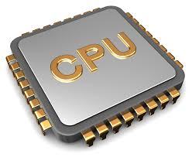
Workload Optimized Silicon Summary
Helping your customers move to a workload-optimize server configurations provides:
  Servers configured to workload, not general purpose computing
  Takes advantage of performance features and characteristics of Intel processors
  Maximizes total cost of ownership
  Maximizes return on investment
Notes:
Customers select the best datacenter solution based on many factors, including the business case, the workload characteristics, the scale of the problem, which application software is being used, and planning for future growth to maximize the return on their data center investment. You need to help your customers add one more important factor in their datacenter decisions – move away from servers configured for general computing and adopting a workload-optimized model that leverages the performance features and characteristics of specific Intel Server processors to maximize their TCO and ROI.

